Slide 1
IMSE 991 Multiple Criteria Decision Making
Lecture 6
Multi-Attribute Utility Theory and MACBETH

Slide 2
Multi-Attribute Utility Theory and MACBETH
Multi-Attribute Utility Theory
MACBETH
Study – Unreliability of MACBETH Applications

Slide 3
Multi-Attribute Utility Theory
Essential Concepts
Every decision maker tries to optimize, consciously or implicitly, a function which aggregates their points of view.
Decision maker’s preference can be represented by a function, called the utility function U.
This function is not known at the beginning of the decision process, so the decision maker must construct it.

Slide 4
Multi-Attribute Utility Theory
Essential Concepts
The utility function is a way of measuring the desirability or preference of objects or alternatives.
Consumer goods
Services
The utility score is the degree of well-being those alternatives provide to the decision maker.

Slide 5
Multi-Attribute Utility Theory
Essential Concepts
The utility function is composed of various criteria which enable the assessment of the global utility of an alternative.
Decision maker assesses individual criteria which are called the marginal utility score.
Marginal utility score are aggregated into the global utility score.

Slide 6
Multi-Attribute Utility Theory
Formulation
Each alternative of set A is evaluated on the basis of function U and receives a “utility score” U(a)

Slide 7
Multi-Attribute Utility Theory
Essential Concepts
There is no issue of incomparability between alternatives since the utility scores are always comparable (real numbers)
The preference relationship on A is transitive

Slide 8
Types of Utilities
Different kinds of utility:
Experienced utility
E.g. Pain during treatment
Remembered utility
E.g. Pain remembered after treatment
Predicted utility
Do people know what will be good for them?
Decision utility
Do people use their knowledge when making decisions?

Slide 9
Utility Theory Axioms
Orderability: Given any two states, a rational agent much either prefer one to the other or else rate the two as equally preferable
Transitivity: Given any three states, if an agent prefers A to B and prefers B to C, then the agent must prefer A to C

Slide 10
Utility Theory Axioms
Continuity: If some state B is between a and C in preference, then there is some probability p for which the rational agent will be indifferent between getting B for sure and that yields A with a probability p and C with a probability 1-p.

Slide 11
Utility Theory Axioms
Substitutability: If an agent is indifferent between A and B, then the agent can substitute B for A
Monotonicity: If A and B have the same outcome, but an agent prefers A to B, then the agent prefers A with the view of a higher probability for outcome.

Slide 12


What do Axioms Guarantee?
1) Utility principle
There exists a monotonic function that numerically encodes preferences
2) Maximum expected utility principle
Utility of a circumstance is the expectation of the utilities

Slide 13
Multi-Attribute Utility Theory
Additive Model
Denote by F the set of q criteria f_{j} (j = 1, …, q).
Evaluations of the alternatives f_{j}(a_{i}) are transformed into marginal utility contributions, U_{j} to avoid scaling problems (unequal units)
Marginal utility scores are aggregated with a weighted sum or addition
Most popular and widely used

Slide 14
Multi-Attribute Utility Theory
Additive Model
General additive utility function
Where U_{j}(f_{j}) ≥ 0 is usually a non-decreasing function and w_{j} represents the weight of criterion f_{j}. They satisfy the normalization constraint:

Slide 15
Multi-Attribute Utility Theory
Simple Weighted sum is a special case of the model where U_{j} are all linear functions. The utility score corresponds to:

Slide 16
Multi-Attribute Utility Theory
Marginal Utility Function
Best alternative on a specific criterion has a marginal utility score of 1
Worst alternative on a specific criterion has a marginal utility score of 0
If the weights are normalized, the utility score is always between 0 and 1.

Slide 17
Multi-Attribute Utility Theory
Shapes of marginal utility functions are determined by the decision maker
Utility function shapes represent the decision maker’s attitude towards preference of the criterion
Utility functions may be Linear, Logarithmic, Exponential, Step, Quadratic or other
Utility functions are impactful in sensitive analysis and global utility preferences

Slide 18
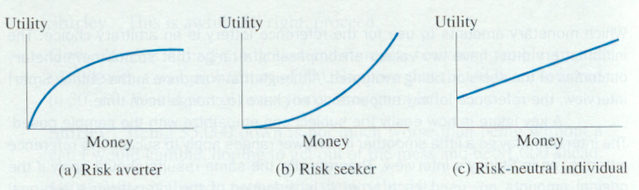
Multi-Attribute Utility Theory
Shapes of marginal utility functions
The following shapes generally apply.
The risk averter has decreasing marginal utility for the object.
Risk seekers like some unfavorable gambles around the object.
Risk neutrality values the object at its face amount.
Logarithmic
Exponential
Linear

Slide 19
Multi-Attribute Utility Theory
Case Study 4.1
Criteria for five smart phones
Price (minimized)
Customer reviews (maximized)
Screen size (maximized)
Storage size (maximized)
The normalization process is based on whether the criterion is minimized or maximized

Slide 20
Multi-Attribute Utility Theory
Case Study 4.1
Performance criteria
Note:
Red indicates worst value based on Min or Max
Green indicates best value based on Min or Max
Raw Data | Price (Euros) | Customer Review | Screen Size (in) | Storage Size (Go)
Min/Max | MIN | MAX | MAX | MAX
SP 1 | 429 | 4 | 4.65 | 32
SP 2 | 649 | 4 | 3.5 | 64
SP 3 | 459 | 5 | 4.3 | 32
SP 4 | 419 | 3.5 | 4.3 | 16
SP 5 | 519 | 4.8 | 4.7 | 16

Slide 21
Multi-Attribute Utility Theory
Case Study 4.1
Normalization function
Maximizing
Minimizing
This will recalculate the utility score so that it falls between 0 and 1.

Slide 22
Multi-Attribute Utility Theory
Case Study 4.1
Normalization function
Example – Price – Minimize
SP1(price) = (1 + (419 – 429)/(649 – 419))
SP1(price) = (1 + (-10)/(230)) = 0.957
Min/Max | Price (Euros) | Customer Review | Screen Size (in) | Storage Size (Go)
min | 419 | 3.5 | 3.5 | 16
max | 649 | 5 | 4.7 | 64

Slide 23
Multi-Attribute Utility Theory
Case Study 4.1
Rescaled performance table
Normalised Scores | Price (Euros) | Customer Review | Screen Size (in) | Storage Size (Go)
SP 1 | 0.957 | 0.333 | 0.958 | 0.333
SP 2 | 0.000 | 0.333 | 0.000 | 1.000
SP 3 | 0.826 | 1.000 | 0.667 | 0.333
SP 4 | 1.000 | 0.000 | 0.667 | 0.000
SP 5 | 0.565 | 0.867 | 1.000 | 0.000

Slide 24
Multi-Attribute Utility Theory
Case Study 4.1
Each attribute can take on a different utility function, based on the decision maker’s preference

Slide 25
Multi-Attribute Utility Theory
Case Study 4.1
Exponential Utility for price
U₁(a_{j}) = (exp(f’_{j}(a_{i})³) – 1)/(exp(1) – 1)
U₁(a_{j}) = (exp(f’_{j}(a_{i})³) – 1)/1.71
Exp(1) = 2.71, which explains the subtraction of 1 in the nominator as well as the division by 1.71 in order to obtain 1 for the best alternative
 | Exponential Score | Exponential Score | Linear Score | Linear Score
Marginal Utility Scores | Price (Euros) | Customer Review | Screen Size (in) | Storage Size (Go)
SP 1 | 0.814 | 0.069 | 0.958 | 0.333
SP 2 | 0.000 | 0.069 | 0.000 | 1.000
SP 3 | 0.441 | 1.000 | 0.667 | 0.333
SP 4 | 1.000 | 0.000 | 0.667 | 0.000
SP 5 | 0.115 | 0.658 | 1.000 | 0.000

Slide 26
Multi-Attribute Utility Theory
Case Study 4.1

Slide 27
Marginal Utility - Price
Price Euros
 | Raw Data | Marginal Utility
SP4 | 419 | 1.000
SP1 | 429 | 0.814
SP3 | 459 | 0.441
SP5 | 519 | 0.115
SP2 | 649 | 0.000
Exponential function to represent utility

Slide 28
Marginal Utility – Customer Review
Customer Review
 | Raw Data | Marginal Utility
SP 1 | 3.5 | 0.000
SP 2 | 4 | 0.068
SP 3 | 4 | 0.068
SP 4 | 4.8 | 0.651
SP 5 | 5 | 1.000
Exponential function to represent utility

Slide 29
Marginal Utility – Screen Size
Screen Size
 | Raw Data | Marginal Utility
SP 2 | 3.5 | 0.000
SP 3 | 4.3 | 0.667
SP 4 | 4.3 | 0.667
SP 1 | 4.65 | 0.958
SP 5 | 4.7 | 1.000
Linear function to represent utility

Slide 30
Marginal Utility – Storage Size
Storage Size
 | Raw Data | Marginal Utility
SP 4 | 16 | 0.000
SP 5 | 16 | 0.000
SP 1 | 32 | 0.333
SP 3 | 32 | 0.333
SP 2 | 64 | 1.000
Linear function to represent utility

Slide 31
Multi-Attribute Utility Theory
Case Study 4.1
Weights
Weighted marginal utility function
Criteria weights x normalized utility scores
Weights | Price (Euros) | Customer Review | Screen Size (in) | Storage Size (Go)
Weight | 0.35 | 0.35 | 0.15 | 0.15
 | Exponential Score | Exponential Score | Linear Score | Linear Score
Weighted Marginal Utility Scores | Price (Euros) | Customer Review | Screen Size (in) | Storage Size (Go)
SP 1 | 0.285 | 0.024 | 0.144 | 0.050
SP 2 | 0.000 | 0.024 | 0.000 | 0.150
SP 3 | 0.154 | 0.350 | 0.100 | 0.050
SP 4 | 0.350 | 0.000 | 0.100 | 0.000
SP 5 | 0.040 | 0.230 | 0.150 | 0.000

Slide 32
Multi-Attribute Utility Theory
Case Study 4.1
Global Utility Scores and Ranking
Sum across weighted marginal utility functions for each alternative
Final Utility Scores | Scores | Rank
SP 1 | 0.503 | 2
SP 2 | 0.174 | 5
SP 3 | 0.654 | 1
SP 4 | 0.450 | 3
SP 5 | 0.421 | 4

Slide 33
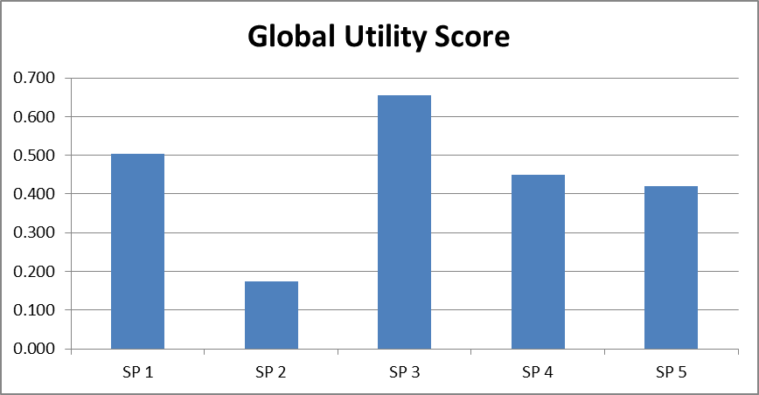
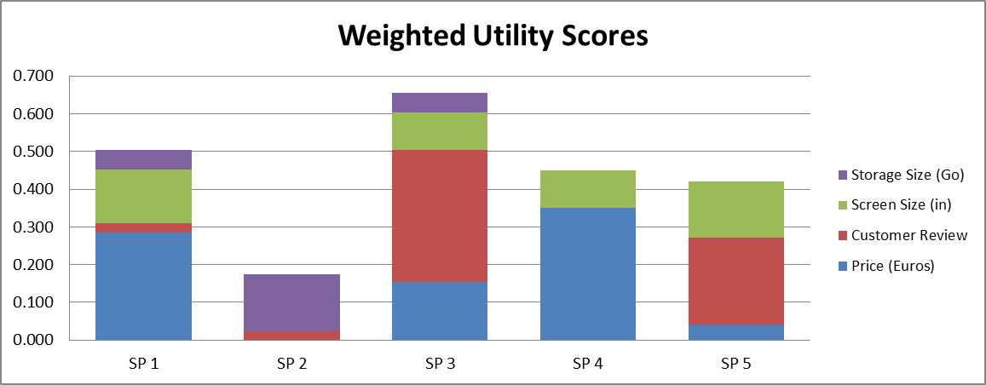
Data Plots

Slide 34
Multi-Attribute Utility Theory
Case Study 4.1
Sensitivity Analysis
Suppose that there is a sale on SP1 and that included an increase to 64GB storage
Raw Data | Price (Euros) | Customer Review | Screen Size (in) | Storage Size (Go)
Min/Max | MIN | MAX | MAX | MAX
SP 1 | 419 | 4 | 4.65 | 64
SP 2 | 649 | 4 | 3.5 | 64
SP 3 | 459 | 5 | 4.3 | 32
SP 4 | 419 | 3.5 | 4.3 | 16
SP 5 | 519 | 4.8 | 4.7 | 16

Slide 35
Multi-Attribute Utility Theory
Case Study 4.1
Sensitivity Analysis
The resulting ranking will change
Final Utility Scores | Scores | Rank
SP 1 | 0.6679 | 1
SP 3 | 0.6542 | 2
SP 4 | 0.4500 | 3
SP 5 | 0.4208 | 4
SP 2 | 0.1742 | 5

Slide 36
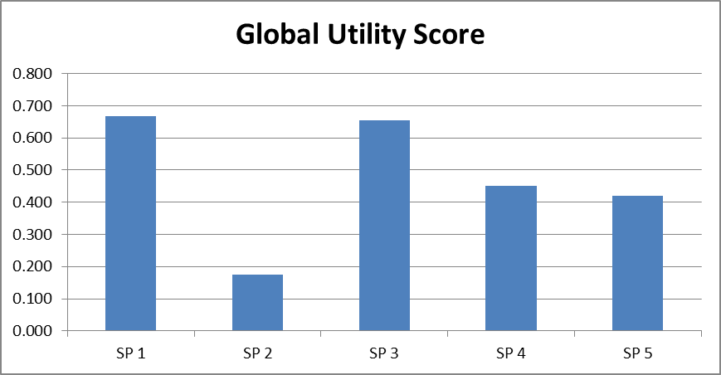
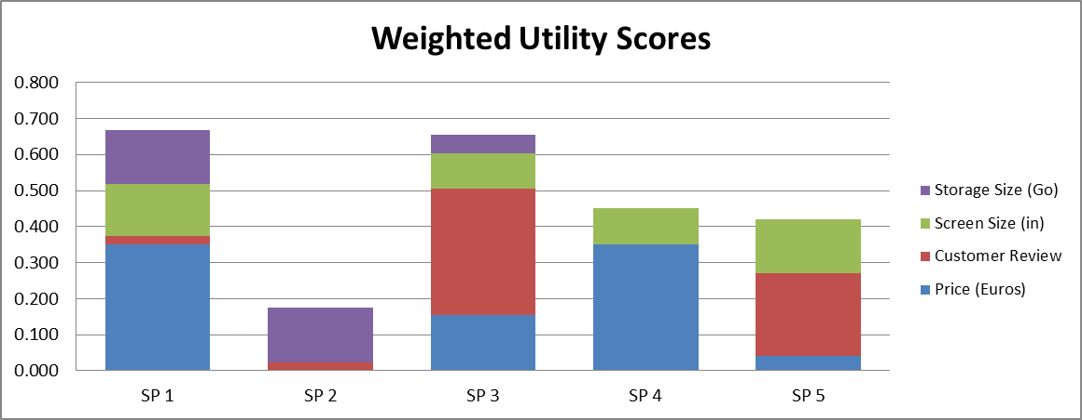
Sensitivity Analysis - Data Plots

Slide 37
MACBETH
MACBETH stands for ‘Measuring Attractiveness by a Categorical Based Evaluation Technique’
Similar to Analytical Hierarchical Process
AHP uses a ratio scale
MACBETH uses an interval scale
The pairwise comparison with AHP and MACBETH is done differently

Slide 38
MACBETH
Example
AHP
Ratio Scale = 5000/1000 = 5
Option 1 is 5 times greater than option 2
MACBETH
Interval Scale = 5000-1000 = 4000
Option 1 is 4000 more incrementally than Option 2

Slide 39
MACBETH
Three Step to Obtain a Ranking
Structure the problem
Enter pairwise comparisons
Calculate the attractiveness
You must also consider the consistency of the preferences as with AHP

Slide 40
MACBETH
Caterer Selection
Quality
Consumables
Service
Price
Drinks
Food
Reliability
Flexibility
Value Tree
Information use in the decision in regards to quality, but not criteria nodes
Criteria used in the evaluation

Slide 41
MACBETH
Score Calculation
Weighting criteria – Measures the attractiveness of each criterion in relation to the top goal
Scores of options – Represents the attractiveness of an option to one specific criteria

Slide 42
MACBETH
Score Calculation
Overall score of options
Criteria weight and option scores are only intermediate results to calculate the overall score of options.
Ranked with regards to a single criterion and then overall goals

Slide 43
MACBETH
Score Calculation
The attractiveness of each criterion is evaluated pairwise
The options are compared pairwise with regard to each criterion
Five different judgement matrices are required which include four local score options with regards to each criterion and one weighted criteria score

Slide 44
MACBETH
Seven Semantic Categories
User needs only to provide the qualitative judgement about the difference of attractiveness between two options
Quantitative Scale | Semantic Categories
0 | no
1 | very weak
2 | weak
3 | moderate
4 | strong
5 | svery strong
6 | extreme

Slide 45
MACBETH
Example
Caterer Options
Internal Caterer
Indian Caterer
Chinese Caterer
Japanese Caterer
Decision Criteria
Quality
Price
Reliability
Flexibility

Slide 46
MACBETH
Rank the criteria in order of importance
Complete the matrix of judgements
No need to create “bottom” half of matrix due to reciprocal relationships
 | Quality | Price | Reliability | Flexibility
Quality | no | very weak | weak | moderate
Price |  | no | very weak | weak
Reliability |  |  | no | weak
Flexibility |  |  |  | no

Slide 47
MACBETH
The MACBETH method is typically performed using a software program to calculate the weights and scores
Least attractive option is grounded to 0
List of conditions reflecting the user’s judgements are set
A linear optimization is used to minimize the score of the most attractive option/criterion
Multiple solutions may exist
Inconsistencies in the scoring are not well tolerated by the program

Slide 48
MACBETH
Incompatibility Check
Two types of judgement in the process
Comparative judgement – two actions on a semantic category
Semantic judgement – comparison between two comparative judgement

Slide 49
MACBETH
Incompatibility Check
Type of Incompatibility in MACBETH
Incoherence inconsistency – conflict between comparative judgement and semantic judgement
Semantic inconsistency – tests two paths between two points to see if they have the same length

Slide 50
MACBETH
Discussion
Not an overly practical MCDM method
Other methods can handle these types of problems
Lack of consistency impacts the ability to solve the problems

Slide 51
MACBETH
Discussion
The decision maker will be forced to enter judgments proposed by MACBETH software to be able to run the program
The final ranking may not reflect the decision maker’s wished
Several optimal solutions may be obtained
Differing rankings may confuse the decision maker

Slide 52
MACBETH
In many ways, this method violates some of the fundamental ideas in developing decision models, i.e., must be easy to use, must be easy for the decision maker to understand, support the goals and objectives of the organization, not the goals and objectives of using a method!

Slide 53
Study – Unreliability of MACBETH
Paper – An Example on the Unreliability of MACBETH Applications
Presented at: 4th International Conference on Production Research - ICPR Americas’ 2008
Valerio A.P. Salomon

Slide 54
Study - Unreliability of MACBETH
Three different approaches were used to decide on a new auto
AHP
MACBETH
Cash Flow Analysis
Comparison made with the results generated by the three approaches

Slide 55
Study - Unreliability of MACBETH
Real data was used and involved different cost considerations and similar features
Body type, comfort and convenience, interior specifications, horsepower
Price – Initial cost of vehicle
Tradeoffs exist with decision

Slide 56
Study - Unreliability of MACBETH
AHP Application
Resulting priorities of criteria
Accepted as consistent

Slide 57
Study - Unreliability of MACBETH
AHP Application
Alternative priorities for each criterion

Slide 58
Study - Unreliability of MACBETH
AHP Application
Alternative priorities for each criterion

Slide 59
Study - Unreliability of MACBETH
MACBETH Application
Ranges of data established for MACBETH Application

Slide 60
Study - Unreliability of MACBETH
MACBETH Application
Alternative attractiveness for each criterion
Best value = 1, worst value = 0, linear interpolation for intermediate values

Slide 61
Study - Unreliability of MACBETH
MACBETH Application
Determine the priorities of the criterion with judgements provided by the decision-maker
Six semantic categories of difference of attractiveness are possible answers

Slide 62
Study - Unreliability of MACBETH
MACBETH Application
Judgement matrix and priorities of the criteria
Priority vector is obtained with a LP model
Cannot be conducted easily with spreadsheets
Free demonstration software from www.m-Macbeth.com
Neutral expresses the worst level of performance in all criterion
Needed to compute the priority for the less preferable criteria
If Neutral is not included, LP model may return zero for the priority of a criterion

Slide 63
Study - Unreliability of MACBETH
MACBETH Application
Judgement matrix and priorities of the criteria

Slide 64
Study - Unreliability of MACBETH
MACBETH Application
Alternative overall attractiveness
Vector obtained by multiplying the alternative local attractiveness by the criteria priority vector

Slide 65
Study - Unreliability of MACBETH
Cash-Flow Analysis
Assume 15k miles driven per year
$2 per gallon of fuel
Annual interest rate 5%
Costs at the end of the 3rd year
Total Costs
A1 = $30,810
A2 = $28,120
A3 = $24,845

Slide 66
Study - Unreliability of MACBETH
Comparison of Results
AHP and Cash-flow analysis are the same
MACBETH is different - primary reasons cited
Use of the 0 to 6 scale
Inclusion of a virtual element for the judgements on the criteria priority (additional judgements and subjectivity of neutral judgements)

Slide 67
Study Discussion
Comparison of methods and results which could be repeated with other methods.
Especially like the use of the Cash-Flow analysis as a means of comparison
Demonstrates use of appropriate methods and tools for comparisons.

Slide 68
IMSE 991 Multiple Criteria Decision Making
Lecture 6
Multi-Attribute Utility Theory and MACBETH

